Slide 1
Movie ticket booking system
Supervised by :
Md. Shafiul Alam Forhad , Assistant Professor, Department of CSE, CUET
Md. Atiqul Islam Rizvi, Lecturer, Department of CSE, CUET
Presented by :
Kowshik Chowdhury (1804119) Salman Farsi (1804102)
Md. Sajidul Mowla (1804100)
Antu Chowdhury (1804112)
‹#›
Notes:
‹#›
*

Slide 2
ER Diagram

Slide 3
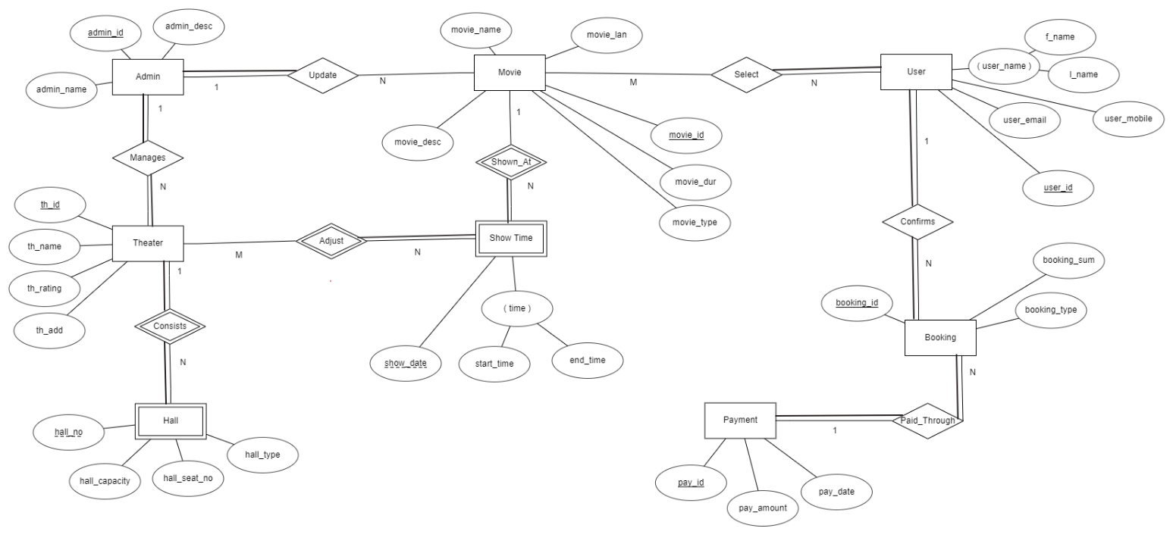
Notes:
ER Diagram

